Slide 1
Waste To WoW: Home Waste Management Recommendation System - Recycling or Upcycling
Team 7
Krishna Sameera Surapaneni
Siddharth Solanki
Sonali Arcot
Vidushi Bhati

Slide 2
Table of contents
01
04
02
03
Data Management Plan
Project Resource Requirement & Plan
05
Project Development Methodology
Project Schedule
Project Organization Plan

Slide 3
01
Data Management Plan

Slide 4
Project Collection Approaches: The project relies heavily on data collecting, which includes merging information from TrashBox, Mendeley, and other sources to create a comprehensive garbage dataset that categorizes waste as biodegradable, recyclable, hazardous, and household products. TrashBox, the major source, provides 17,785 photos across a variety of waste categories.
Management Methods: Effective data management comprises of high-quality image collection, structured storage, and secure handling, as well as the capture of important metadata and the use of standardized methods for easy retrieval and analysis.

Slide 5
Storage Methods: Managing varied picture datasets, this research uses OneDrive for collaborative access, specialized tools to assure data quality, methodically organizes data, and automates backups for data protection, ensuring the project's efficient advancement.
Usage Mechanisms: This study focuses on effective data management and team communication by employing primary datasets, assuring data quality through cleaning and augmentation, utilizing OneDrive for shared access, and utilizing GitHub for backups and data security.

Slide 6
02
Project Development Methodology

Slide 7
Intelligent System Development Cycle
CRISP-DM following Waterfall
Sequential phases: Each phase of this project is completed before the next one begins.
Well-Defined Requirements: the basic requirements are well-understood and would not be changed significantly during the course of the project.
Relatively Stable: The process, tools, technology, and models used are relatively stable with some scope for modification to be taken into consideration.
Documentation: at every stage of our project, there is a need for comprehensive documentation
It is a well-structured approach
We have chosen a structured approach that aligns with the CRISP-DM framework, which itself follows waterfall approach with six distinct phases.

Slide 8
Planned Development Processes and Activities
Data Preparation
Modeling
Deployment
Data Understanding
Evaluation
Business Understanding
1
2
3
4
5
6
We utilize CRISP_DM model with its six phases

Slide 9
03
Project Organization Plan

Slide 10
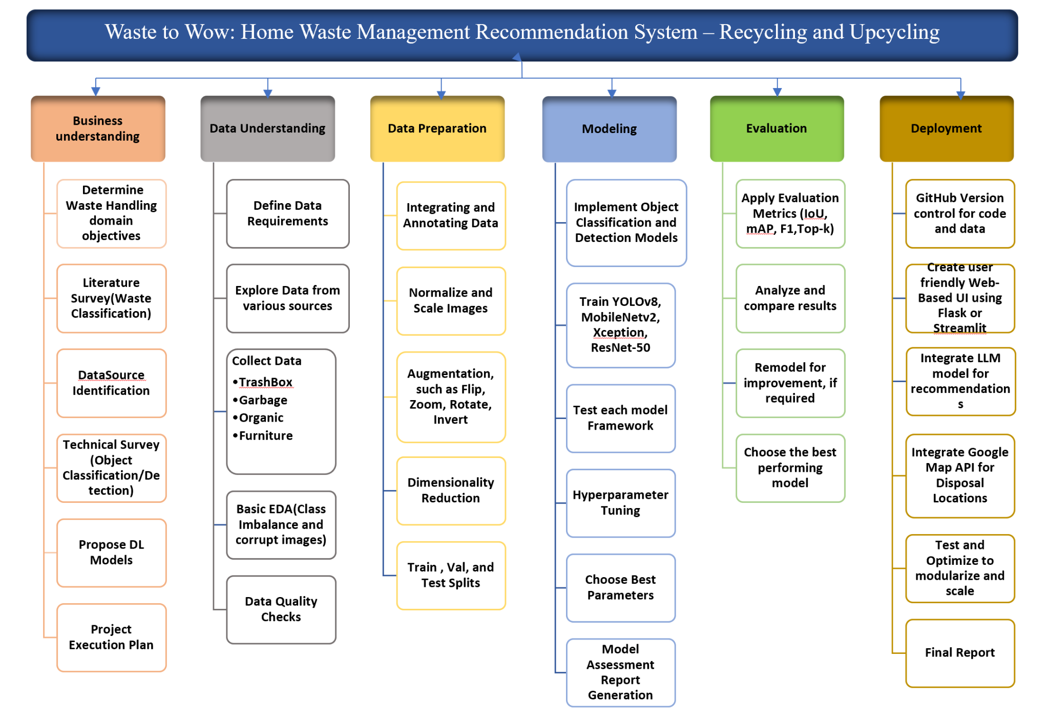

Slide 11
04
Project Resource Requirement & Plan

Slide 12
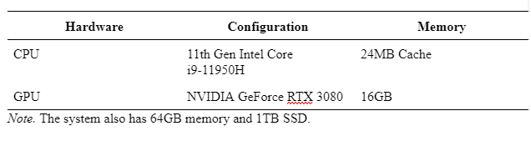
Hardware Requirements

Slide 13
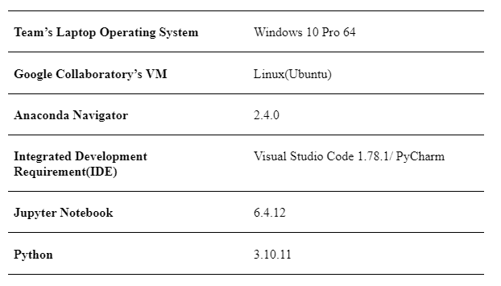
Software Requirements

Slide 14
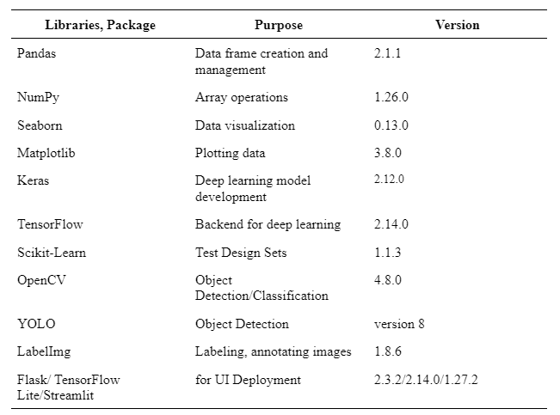
Tools and Licences

Slide 15
05
Project Schedule

Slide 16
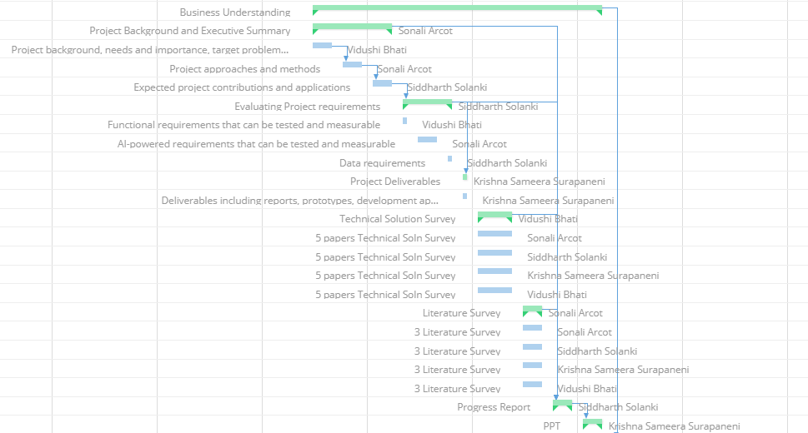
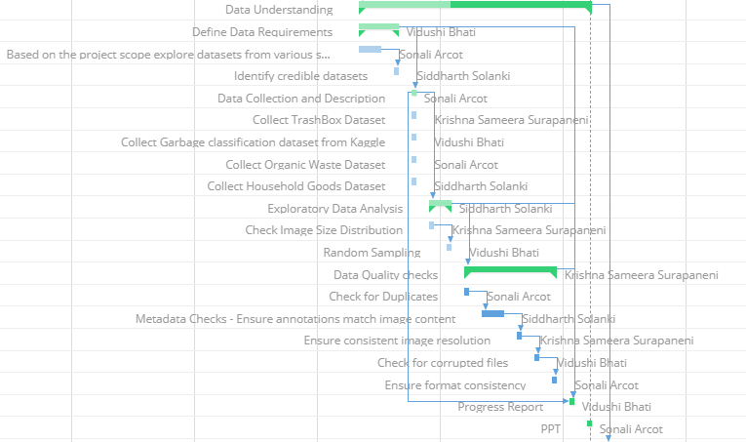
GANTT CHART
Business Understanding
Data Understanding

Slide 17
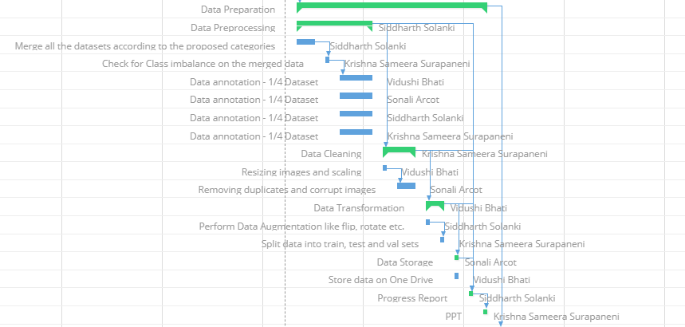
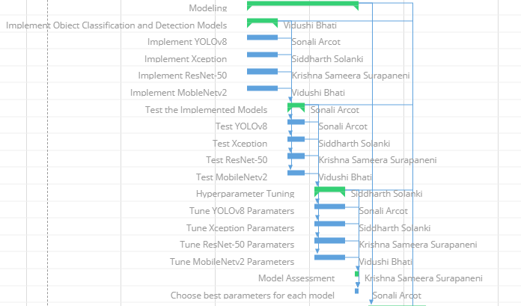
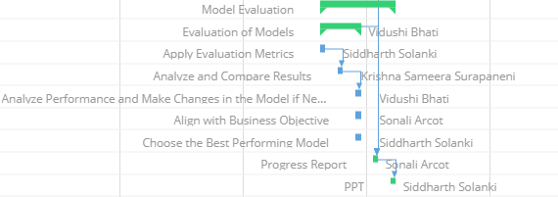
Data Preparation
Modeling
Model Evaluation

Slide 18
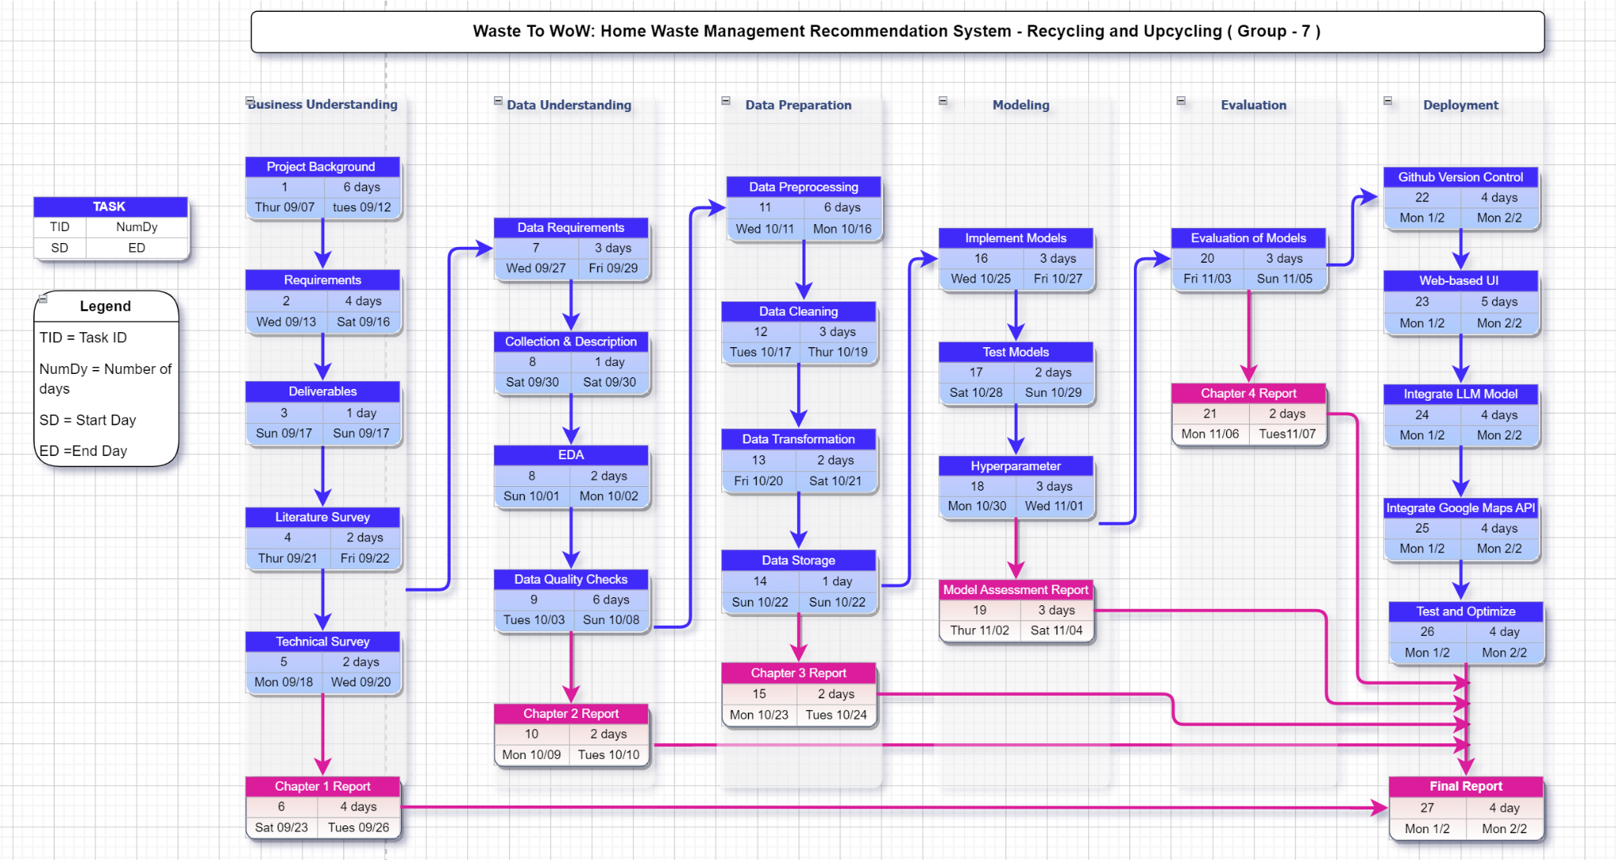
PERT CHART

Slide 19
Thank You!

